Slide 1
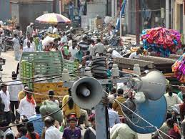
NOISE POLLUTION
BY
P.THAMARAISELVI
S.SOWMIYA
M.SHARMILA
D.DHARSHSHINI
M.MENAKA

Slide 2

NOISE POLLUTION:
Noise pollution, or sound pollution, is the propagation of noise or sound with ranging impacts on the activity of human or animal life, most of which are harmful to a degree.
The source of outdoor noise worldwide is mainly caused by machines, transport and propagation systems.
Noise pollution is caused by noisy machines, loudspeakers, vehicles, and other objects producing sound at high decibels

Slide 3
SOURCES OF NOISE POLLUTION:
1.Industrialization:
Most of the industries use big machines which are capable of producing noise. Apart from that, various equipment’s like compressors, generators, exhaust fans, grinding mills also participate in producing noise.
2. Poor Urban Planning:
In most of the developing countries, poor urban planning also play a vital role. Congested houses, large families sharing small space, parking lots, street noise, honking, commercial zone leads to noise pollution which disrupts the environment of society.
3. Social Events:
Noise is at its peak in most of the social events. Whether it is marriage, parties, pub, disc or place of worship, people normally defy rules set by the local administration and create nuisance in the area. People play songs on full volume and dance till midnight which makes the condition of people living nearby pretty worse.
4. Transportation:
Large number of vehicles on roads, aero planes, trains produce heavy noise. The high noise leads to a situation wherein a normal person lose the ability to hear properly.

Slide 4
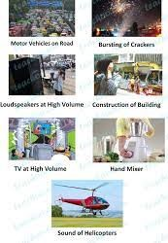
5.Urbanization :
Increasing population density and urban development lead to higher noise levels.
6.Recreational Activities:
Events like concerts, sports matches, and festivals can be major source.
7.Household Activities:
Appliances like vacuum cleaners, lawnmowers, and power tools can generate noise.
8.Lack of Urban Planning:
Poor city planning can lead to congestion, creating noise hotspots..
9.Social and Cultural Activities:
Celebrations, ceremonies, and religious events can result in elevated noise levels.

Slide 5
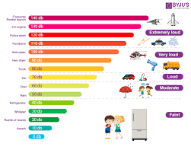
TYPES OF NOISE POLLUTION:
Following are the three types of pollution:
Transport Noise
Neighbourhood Noise
Industrial Noise

Slide 6
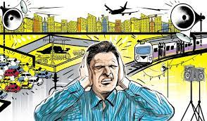
Transport Noise:
It mainly consists of traffic noise which has increased in recent years with the increase in the number of vehicles. The increase in noise pollution leads to deafening of older people, headache, hypertension, etc.
Neighbourhood Noise:
The noise from gadgets, household utensils etc. Some of the main sources are musical instruments, transistors, loudspeakers, etc.
Industrial Noise:
It is the high-intensity sound which is caused by heavy industrial machines. According to many researches, industrial noise pollution damages the hearing ability to around 20%.

Slide 7
EFFECTS OF NOISE POLLUTION:
Noise pollution can be hazardous to human health in the following ways:
Hypertension:
It is a direct result of noise pollution which is caused due to elevated blood levels for a longer duration.
Hearing loss:
Constant exposure of human ears to loud noise that are beyond the range of sound that human ears can withstand damages the eardrums, resulting in loss of hearing.
Sleeping disorders:
Lack of sleep might result in fatigue and low energy level throughout the day affecting everyday activities. Noise pollution hampers the sleep cycles leading to irritation and an uncomfortable state of mind.
Cardiovascular issues:
Heart-related problems such as blood pressure level, stress and cardiovascular diseases might come up in a normal person and a person suffering from any of these diseases might feel a sudden shoot up in the level.

Slide 8
PREVENTION OF NOISE POLLUTION:
Musical instruments’ sound should be controlled to desirable limits
.
Dense tree cover is useful in noise pollution prevention
.
Honking in public places like teaching institutes, hospitals, etc. should be banned.
In commercial, hospital, and industrial buildings, adequate soundproof systems should be installed
.
Explosives should not be used in forest, mountainous and mining areas.

Slide 9
EXAMPLES OF NOISE POLLUTION:
Unnecessary usage of horns
Using loudspeakers either for religious functions or for political purposes.
Unnecessary usage of fireworks
Industrial noise
Construction noise
Noise from transportation such as railway and aircraft

Slide 10
DISTURBANCES IN NOISE POLLUTION:
SLEEP DISTURBANCE:
Uninterrupted sleep is known to be a prerequisite for good physiologic and mental functioning in
healthy individuals. Environmental noise is one of the major causes of disturbed sleep. When sleep
disruption becomes chronic, the results are mood changes, decrements in performance, and other
long-term effects on health and well-being.
CARDIOVASCULAR DISTURBANCE:
A growing body of evidence confirms that noise pollution has both temporary and permanent
effects on humans (and other mammals) by way of the endocrine and autonomic nervous systems .
It has been postulated that noise acts as a nonspecific biologic stressor eliciting reactions that
prepare the body for a fight or flight response. For this reason, noise can trigger both endocrine and
autonomic nervous system responses that affect the cardiovascular system and thus may be a risk
factor for cardiovascular disease. These effects begin to be seen with long-term daily exposure to
noise levels above 65 dB or with acute exposure to noise levels above 80 to 85 dB.

Slide 11
THANK YOU

